Slide 1

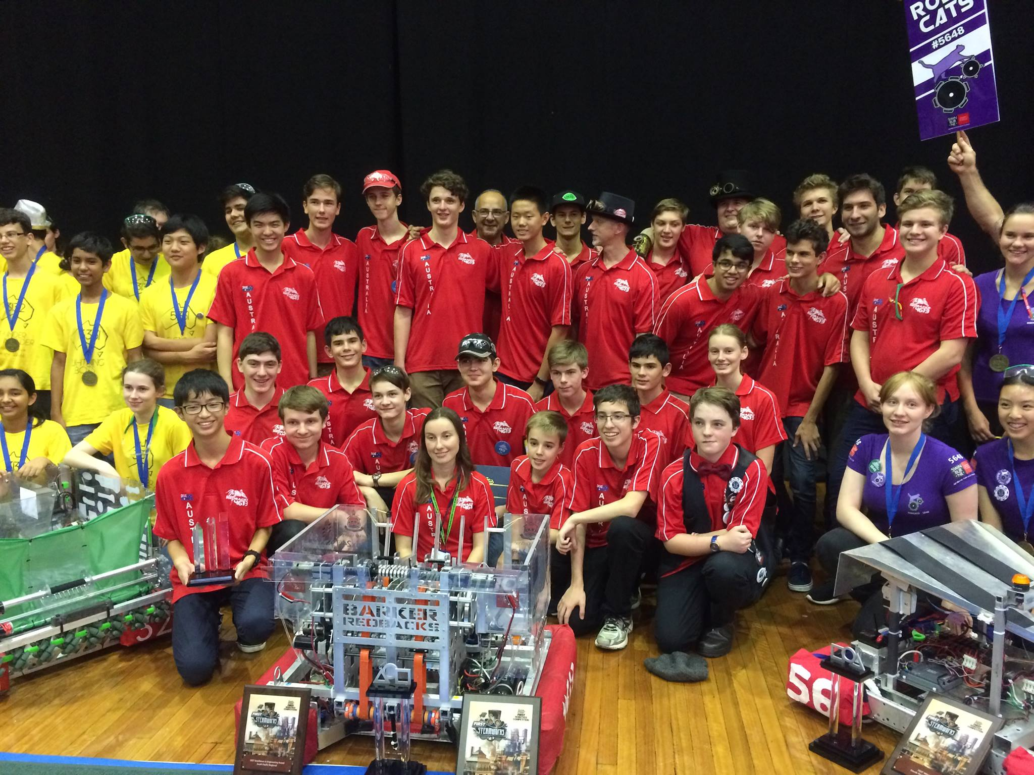
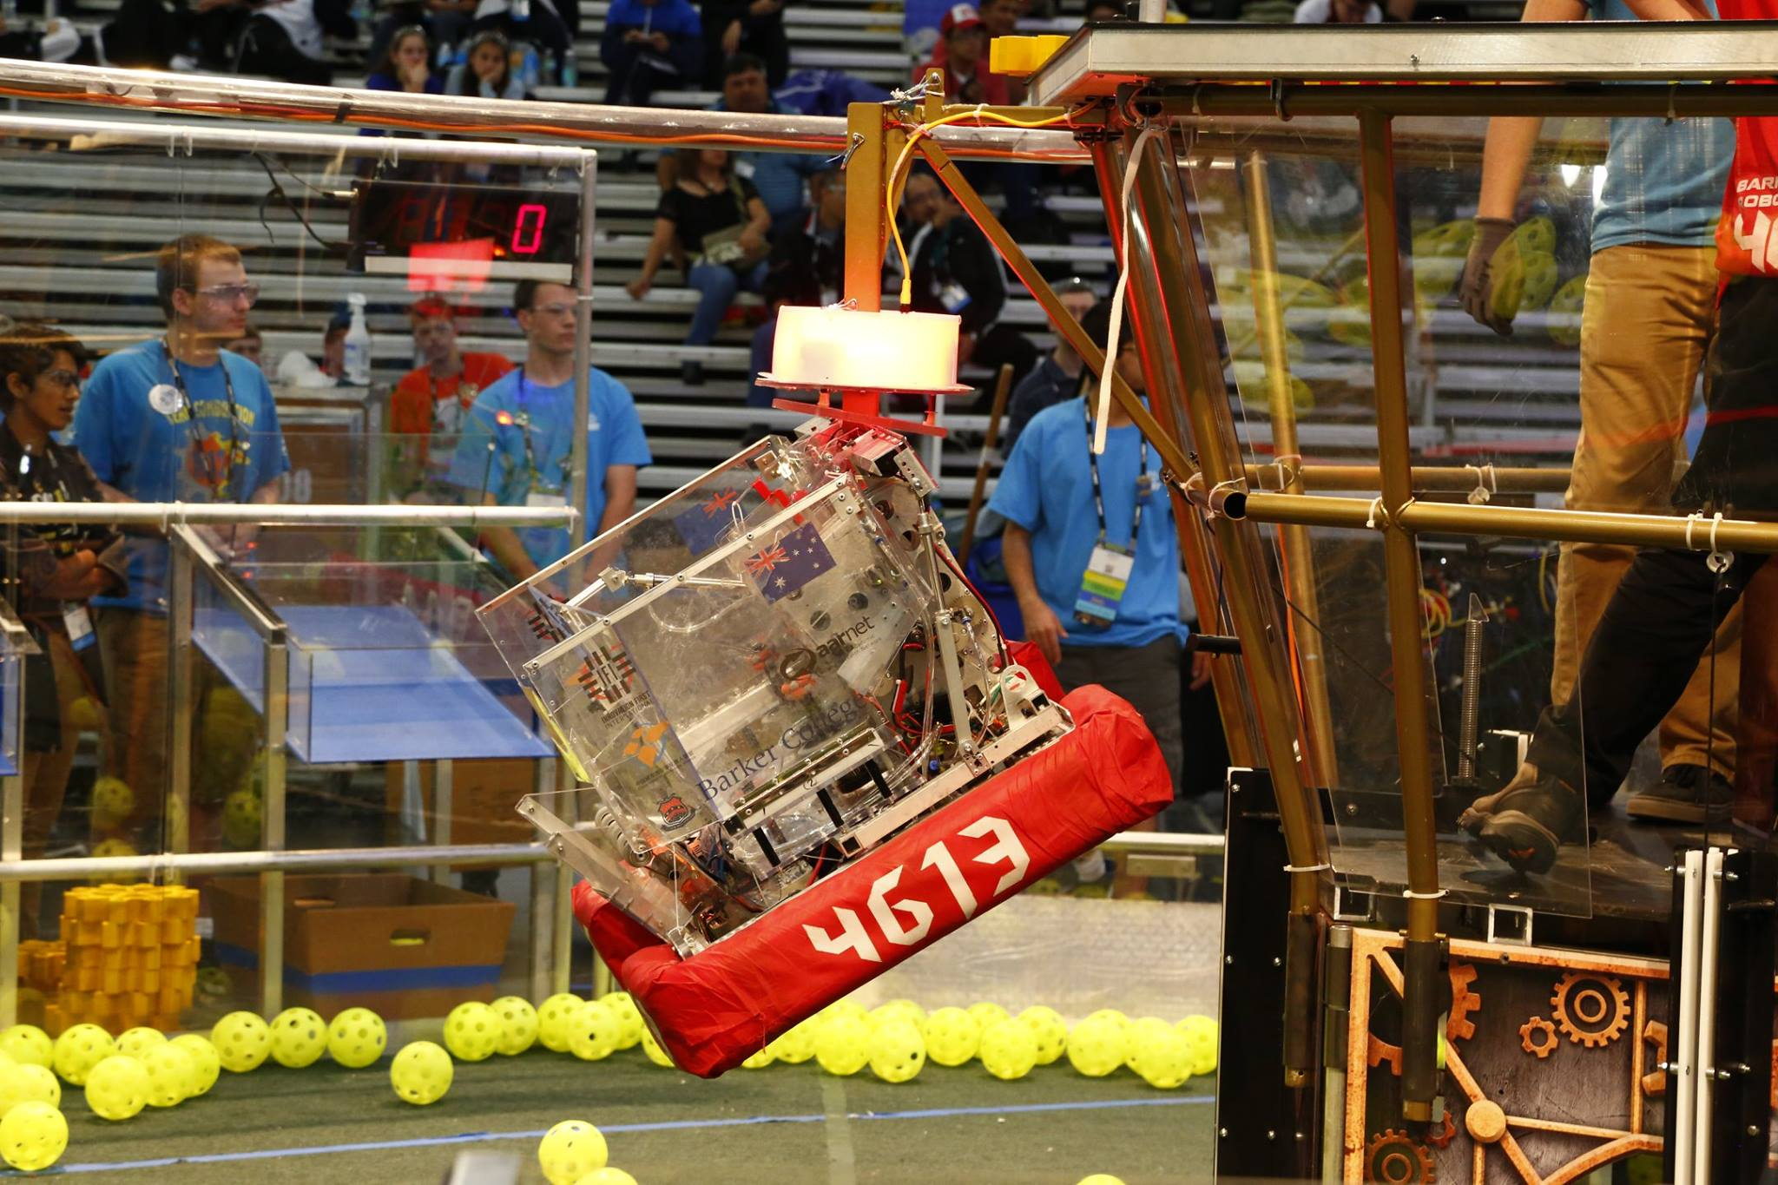
Introduction to (Java) Programming 11 – Object Oriented Programming (OOP) Theory
Matthew Brian

Slide 2
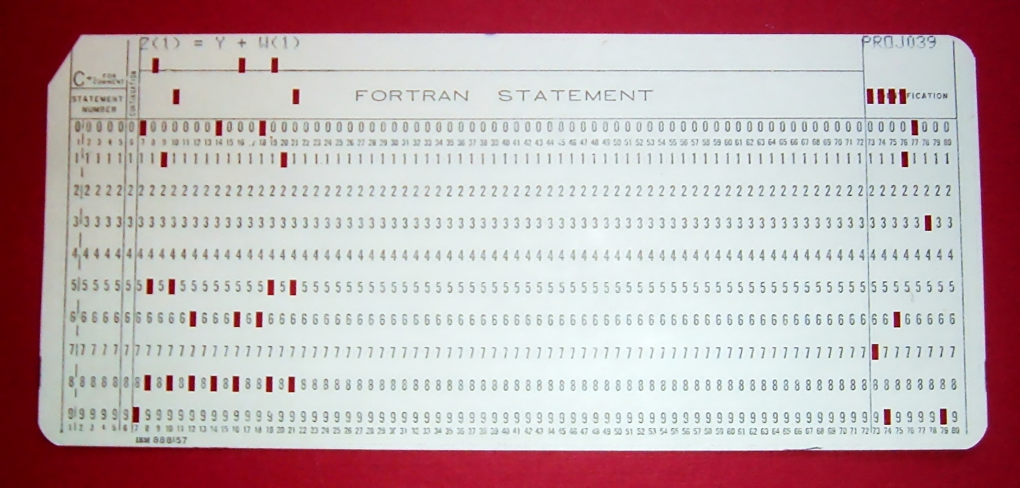
Lesson 11: OOP
Up until now we have ignored the arguably largest topic that the Java programming language is based on, Object Oriented Programming!
Before we get into any code I will explain roughly what it is all about
Java is object-oriented. This means that unlike other programming languages (FORTRAN) that focus on giving the computer imperative “Do This then Do That” commands, it focuses on data
This means that rather then scrapping code and doing something else every time we have to do something new, we can “Recycle” and build upon code that we have, or someone else has, already written
FORTRAN

Slide 3
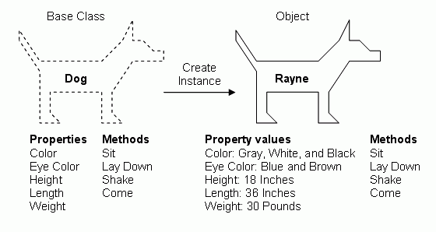
Lesson 11: OOP
In object-oriented languages, you use objects and classes to organise your code to take advantage of this programming concept
What are objects and classes you say?

Slide 4
Lesson 11: OOP
Pretend you are writing a java program that has to keep track of a book production facility
Every book produced only differs slightly from the next one, being in page-size, font-size, line-height, author name etc. Within an object-oriented computer program, every book is an object
But objects aren’t everything, although the books all differ slightly from each other in some way, they all share the exact same characteristics. In an object-oriented program we need a master list that contains every characteristic a book object can have. This master list is called a class
A class could also be seen as a blueprint for the building of a book. It contains all of the book’s characteristics on a page. Where the blueprint says that every book produced will have a “page-size”, the actual book will have page size A5.
It doesn’t just stop at characteristics though – a year after you make this book blueprint, you could have used it to produce a million other books
If you don’t understand the analogy here is the summary:
A programmer first writes code to describe a class (Book Blueprint)
Once the program runs, the computer creates objects (Books) from the (Blueprint) class
Analogy inspired by “Java for Dummies 6th Edition”

Slide 5
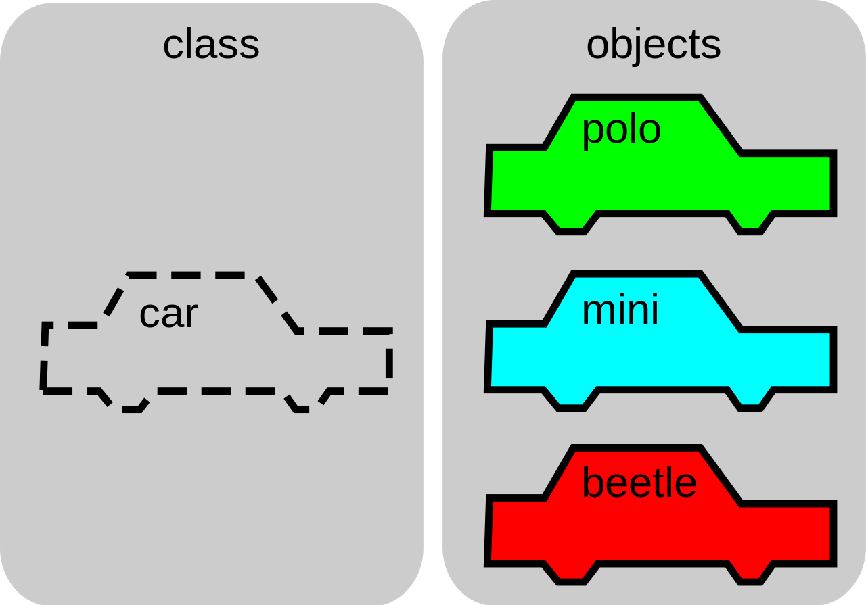
Lesson 11: OOP
This might be terribly confusing for some of you, so if you have any questions ask them now

Slide 6
Lesson 11: OOP
But what is so good about OOP? Why don’t we just use “Do This/Do That” programming languages?
Continuing the book analogy, imagine the that you have already written a computer program that keeps track of book creation within the book factory. Then, the boss of the factory decides to modify the books so that they are produced with cover jackets as well as the actual book.
If I were to use a FORTRAN style of computer programming, my instructions would look a lot like this:
This is comparable to you creating a long list of instructions to tell the computer what to do, rather then a blueprint
Get paper from the pile
Print text on the page
Flip page then print text again
. . .
Analogy inspired by “Java for Dummies 6th Edition”

Slide 7

Lesson 11: OOP
To modify this plan, you have to not only sort through the whole list to find and edit the instructions to make the book cover, but the instructions could be on pages 461, 311-816, 14 and 8
To make matters worse, if someone else made the plan, you would have to interpret the complicated instructions of other people, making the task much harder
However, beginning with a class is like beginning with a blueprint. If we want to have a book with a jacket around the outside instead of a book with no jacket, we can start with a generic book blueprint that only has the basic characteristics of a book
Analogy inspired by “Java for Dummies 6th Edition”

Slide 8
Lesson 11: OOP
From this generic blueprint, we can create two more blueprints, one for a book with a jacket, and one for a book without(named the bookWithJacket blueprint and bookNoJacket blueprint)
Our boss at the book factory is amazed that you were able to make these changes so quickly, but being the sceptical man that he is, he poses a question. “You called one of the blueprints the ‘bookWithJacket’ blueprint. How can you do this if it’s just a blueprint for a jacket and not for a whole book’”
You then knowingly answer “The ‘bookWithJacket’ blueprint can say on it, ‘For information about how to make the rest of the book, see the original book blueprint’.”
That way, the bookWithJacket class allows you to describe how to make a whole book, despite the fact that you only described how to make a jacket. The bookWithoutJacket class can do the same.
With this setup we can take advantage of all the work we already did to create the original book blueprint, saving lots of time and money
Analogy inspired by “Java for Dummies 6th Edition”

Slide 9
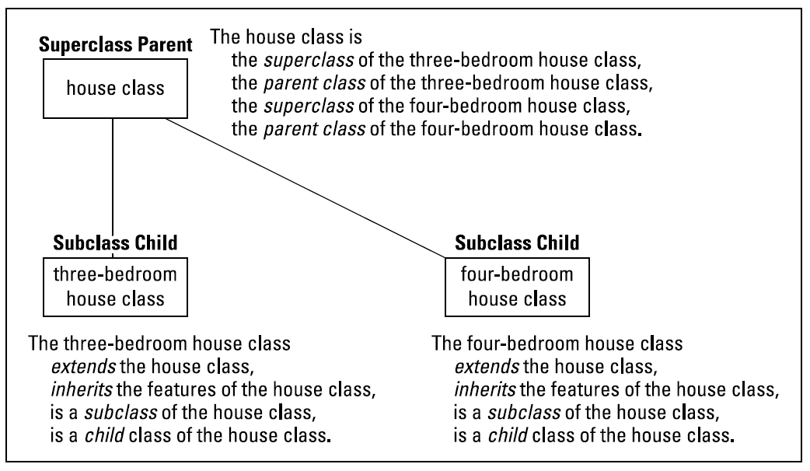
Lesson 11: OOP
In object-oriented programming languages like Java, this is called inheriting the characteristics of the original book class. We also say that the bookWithJacket and bookWithoutJacket classes are extending the original book class, as they are inheriting its characteristics
I can guarantee that you will all be bursting with questions after that, so ask them now ☺

Slide 10
Lesson 11: OOP
The original book class is known as the superclass of the Jacketed and Not-Jacketed book classes.
Similarly, the Jacketed and Not-Jacketed book classes are known as subclasses of the original book class
This can also be stated as parent and child classes.
Going back one last time to the book analogy, you tell the boss that you can reuse the same standard book blueprint again and again and again in the future. Say if someone wants pop-up parts in their book, you could make another subclass of the main book blueprint.
If a subclass wants to change a characteristic of a parent class, they can override elements of the main class, and change what they mean

Slide 11
Lesson 11: OOP
We have learnt that:
Java is an object-oriented programming language
Classes are like blueprints, and objects are what that blueprint describes to be built
These classes contain all the characteristics of the object
OOP is more efficient than other styles of programming because it allows modularity through its system of blueprints, or, classes.
It allows you to steal already written code, and use it in the same, or a different, way
A class that steals code from another class is called a subclass, and the class having code stolen from it is called a superclass
If we want to change certain characteristics of a superclass in a subclass, we have to override them
Final questions time before we get in to utilise these concepts ourselves in Java

